Slide 1
SMART CITY
BY TEAM SPARKPLUG
-Rajesh borate - alok Kumar - Ankur ankit -Dhananjay narayan

Slide 2
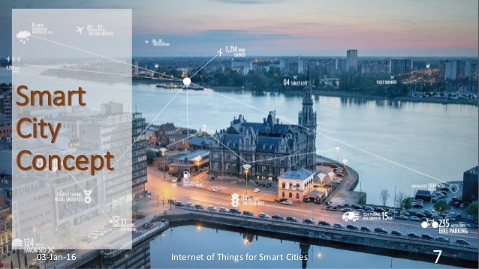
What is a smart city?
A smart city is a municipality that uses information and communication technologies to increase operational efficiency, share information with the public and improve both the quality of government services and citizen welfare.

Slide 3
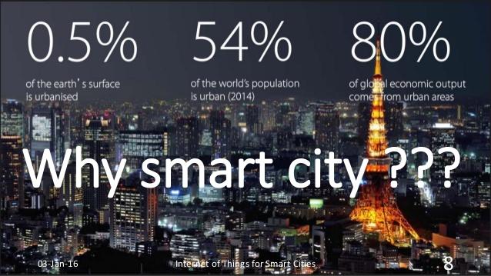

Slide 4
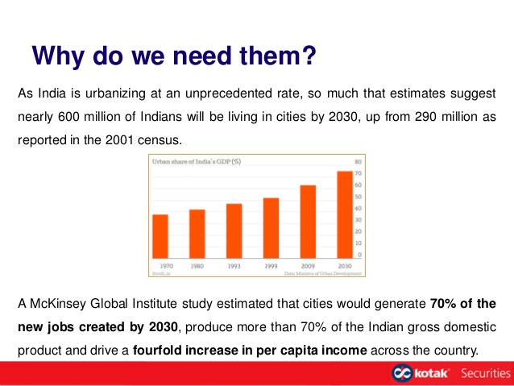

Slide 5


Slide 6
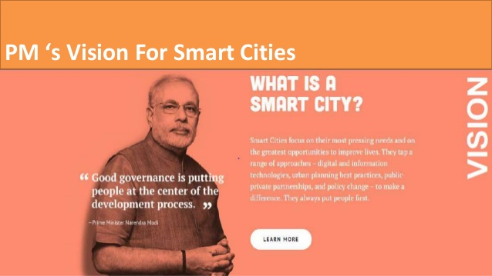

Slide 7
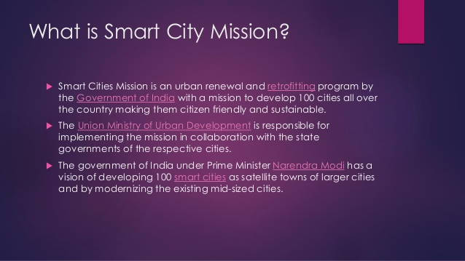

Slide 8
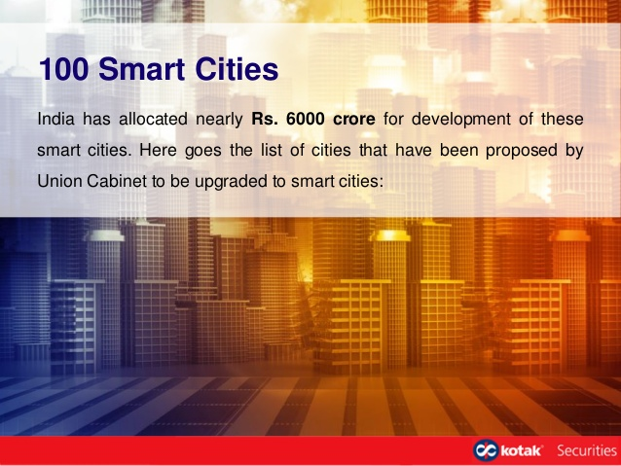

Slide 9
Our take on smart city
The objective of our project is how Internet and Sensors can help to develop a city to a smart city.
We will incorporate some of the classic and trending technologies in our project-
Smart Parking
Smart Street Lights
Smart Garbage Collection
Water Level Monitoring
Air Pollution Sensor

Slide 10
1.Smart parking
The smart parking system uses an app to help drivers find available parking spaces without prolonged circling of crowded city blocks. The smart meter also enables digital payment, so there's no risk of coming up short of coins for the meter.
Sensors, Computers and phone apps can revolutionize the way cities handle their parking spaces.
They are simple devices with straightforward tasks, but they have a huge impact on the way drivers in cities park, just by knowing when cars are parked over them and when they are not.
It is an industry that has been completely overlooked from perspective of modern technologies.
Our parking system accurately tracks the availability of parking spaces inside parking areas of many different places like Malls, Airports, Railway Stations, Cinema Halls etc.

Slide 11
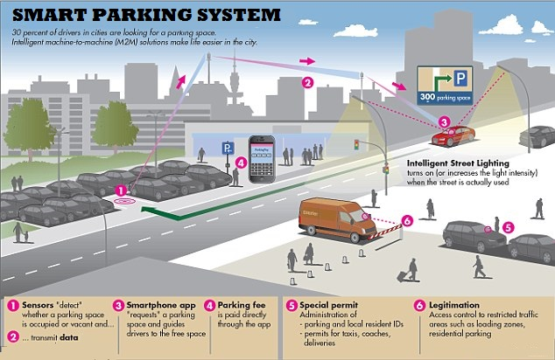

Slide 12
2. Smart Street Lights
We have seen in the number of cities where the street lights is the one of the huge energy expense for a city. Currently we have manual system where the light will be switched ON in the evening before the sunset and they are switched OFF next day morning after there is sufficient light outside. So there is lot of energy waste between ON and OFF timing
Energy conservation and efficiency are major focuses of smart cities. Using smart sensors, smart streetlights dim when there aren't cars or pedestrians on the roadways.

Slide 13
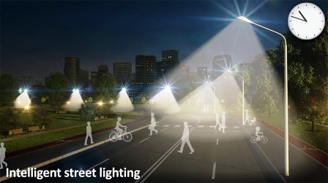

Slide 14
3.SMART GARBAGE COLLECTION
One of the main concerns with our environment has been solid waste management which impacts the health and environment of our society. The detection, monitoring and management of wastes is one of the primary problems of the present era. The traditional way of manually monitoring the wastes in waste bins is a cumbersome process and utilizes more human effort, time and cost which can easily be avoided with our present technologies.
This is our solution, a method in which waste management is automated. This is our IoT Garbage Monitoring system, an innovative way that will help to keep the cities clean and healthy.

Slide 15
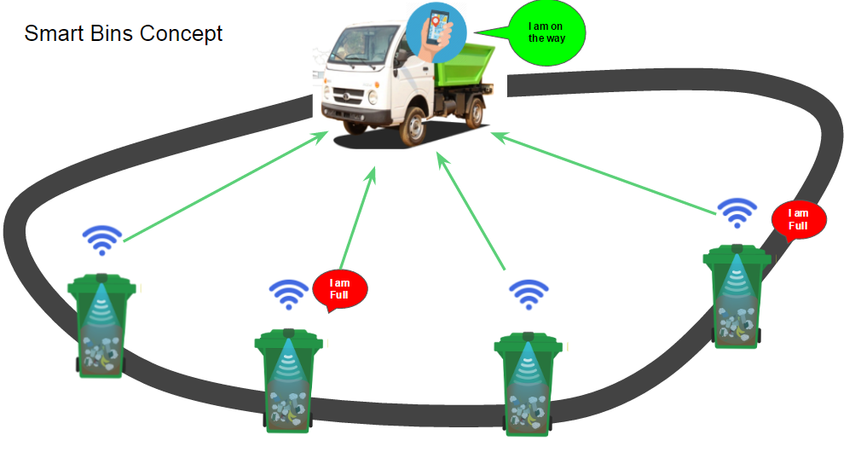

Slide 16
4. Water Level Monitoring
Water is one of the necessities of life. Every government in every country is emphasizing on avoiding water wastage.
Automatic water level monitoring system project explained here is going to measure the water level of a water tank using ultrasonic sensor. The project will automate the water filling in a tank i.e when the water level reaches up to the brim of the tank, the water pump will stop automatically and when the water level in the tank remains up to few centimetres, the pump will start automatically to fill up the tank till the water reaches again up to the brim.

Slide 17
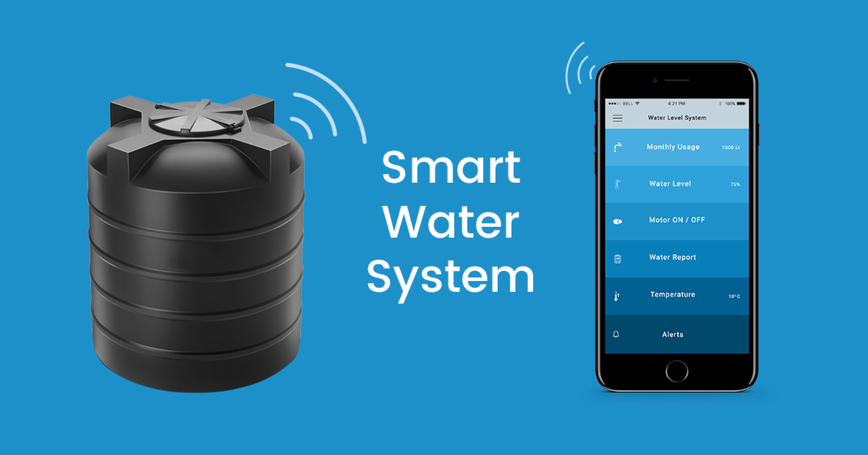

Slide 18
5. Air Pollution Sensor
The main objective of IOT Air Monitoring System is that the Air is a growing issue these days. It is necessary to monitor air quality and keep it under control for a better future and healthy living for all. Due to flexibility and low cost Internet of things (IoT) is getting popular day by day.
With the urbanization and with the increase in the vehicles on road the atmospheric conditions have considerably affected.
Monitoring gives measurements of air pollutant concentrations, which can then be analysed ,interpreted and presented. This information can then be applicable in many ways. Analysis of monitoring data allows us to assess how bad air pollution is.

Slide 19
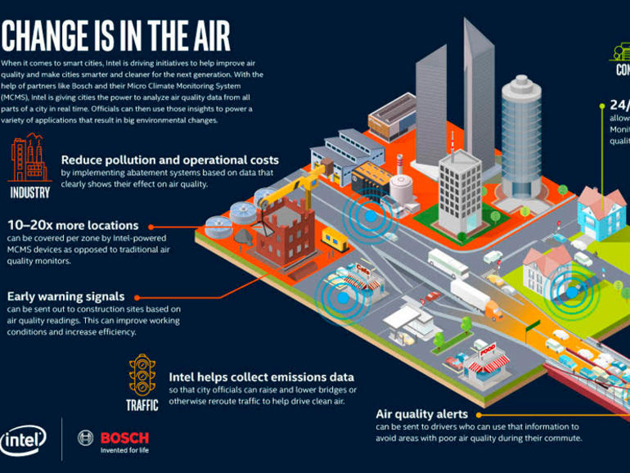

Slide 20
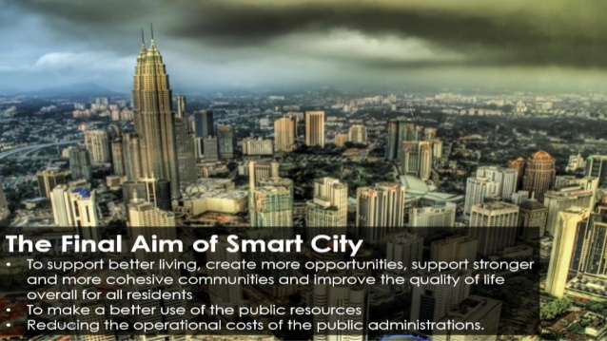

Slide 21


